Slide 1
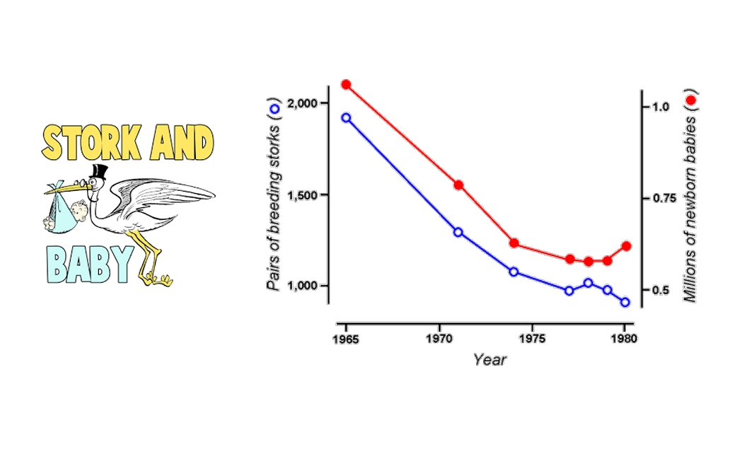


Bivariate Analysis
MSc. Kian Jenab
PhD student
Devision of Terrestrial Ecosystem Research
Centre for Microbiology and Environmental Systems Science
University of Vienna
Email: kian.jenab@univie.ac.at

Slide 2
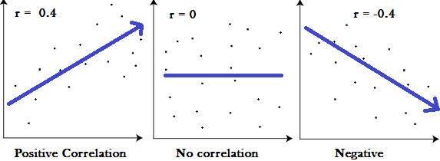
Pearson’s Correlation
Relationship between two quantitative variables
Example: weight and nutrition
ρ or r (Pearson’s correlation coefficient)
-1>r<+1
r=0 No relationship

Slide 3
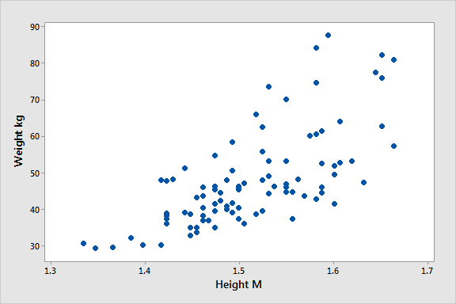
Scatter Plot

Slide 4
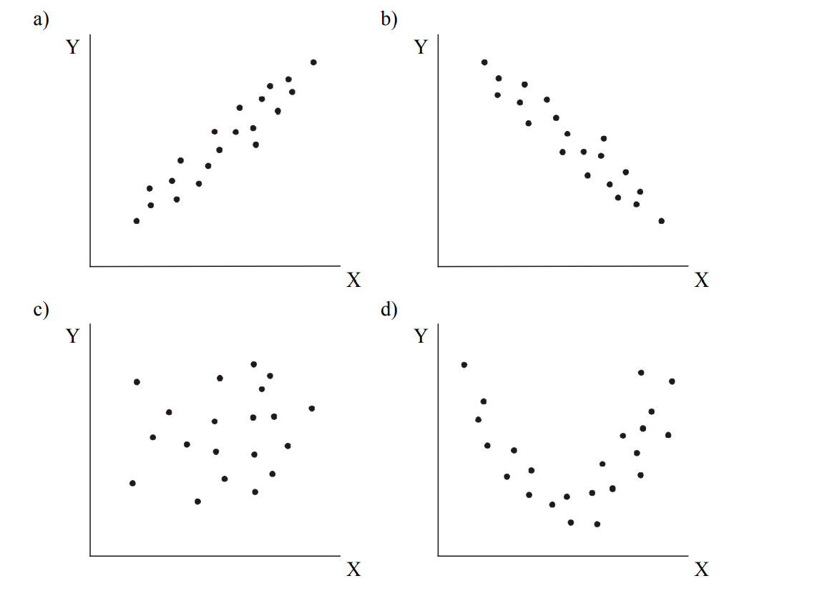

Slide 5
Correlation Coefficient
0 >r< ±0.2 => Very weak
±0.2 >r< ±0.4 => Weak
±0.4 >r< ±0.6 => Average
±0.6 >r< ±0.8 => strong
±0.8 >r< ±1 => Very strong

Slide 6
Pearson’s Correlation Test
H₀: No relationship between variables in population (ρ=0)
P > or = 0.05
H₁: Relationship between variables in population (ρ≠0)
P < 0.05
Assumption:
Two numerical variables must have normal distributions
Non-parametric test:
Spearman's rank correlation test

Slide 7
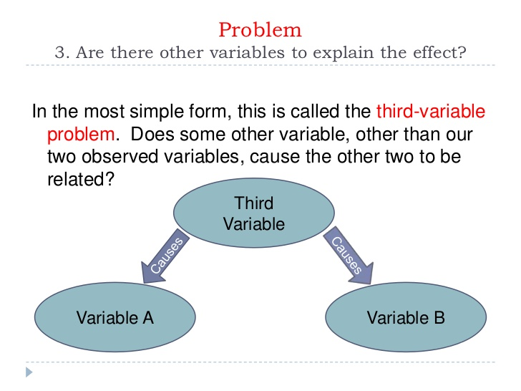
Third Variable

Slide 8
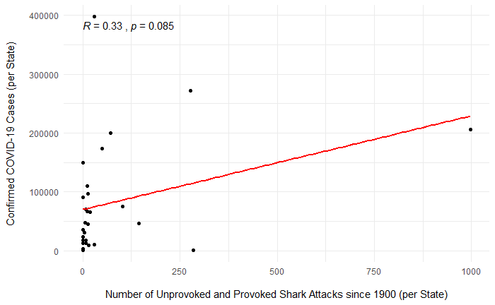

Slide 9
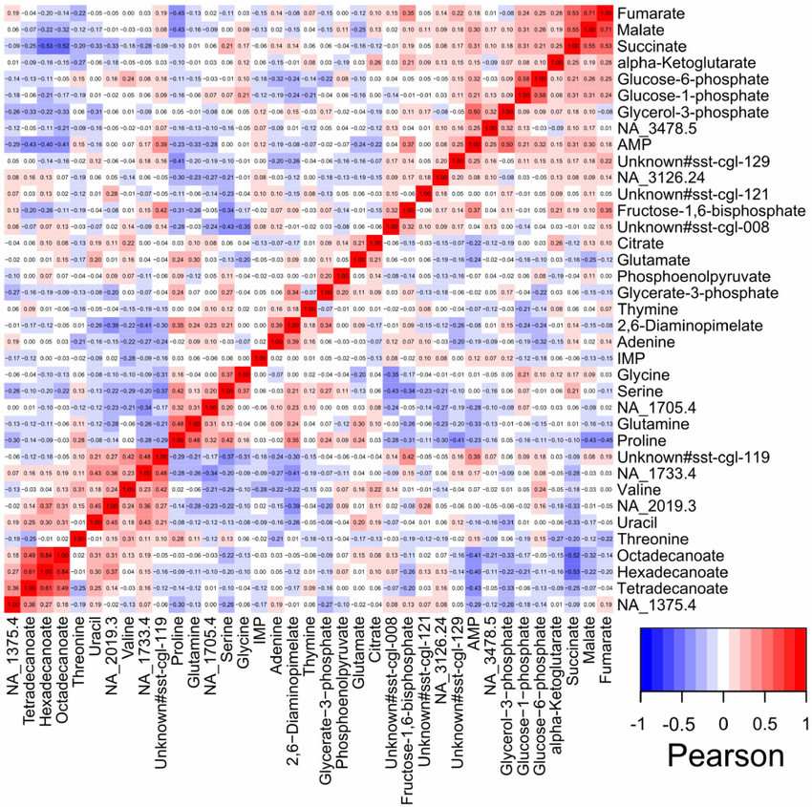
Heatmap

Slide 10


Slide 11
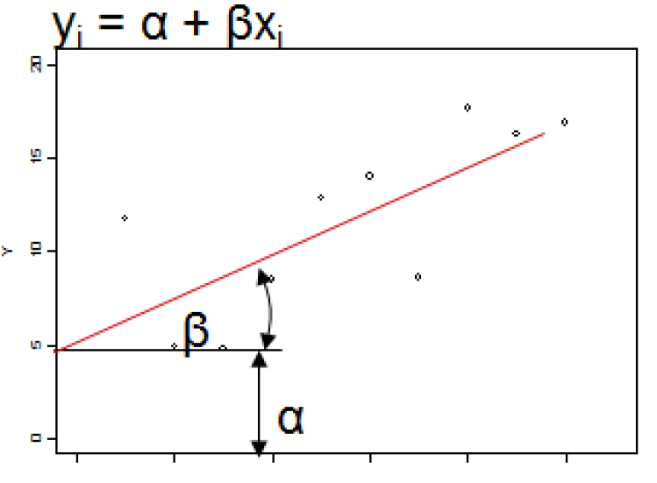
Linear Regression
Using this relationship to predict unknown values of Y from known values of X
Y: response ( Dependant Variable)
x: Predictor (Independent variable)
α: Intercept
β: Slope coefficient (Positive value = Positive correlation)
Example:
Height and Weight
Weight and Nutrition
Sugar content and Blood sugar

Slide 12
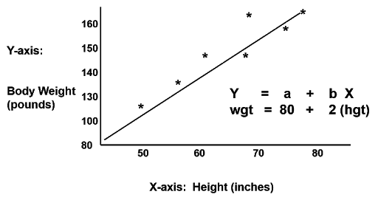

Slide 13
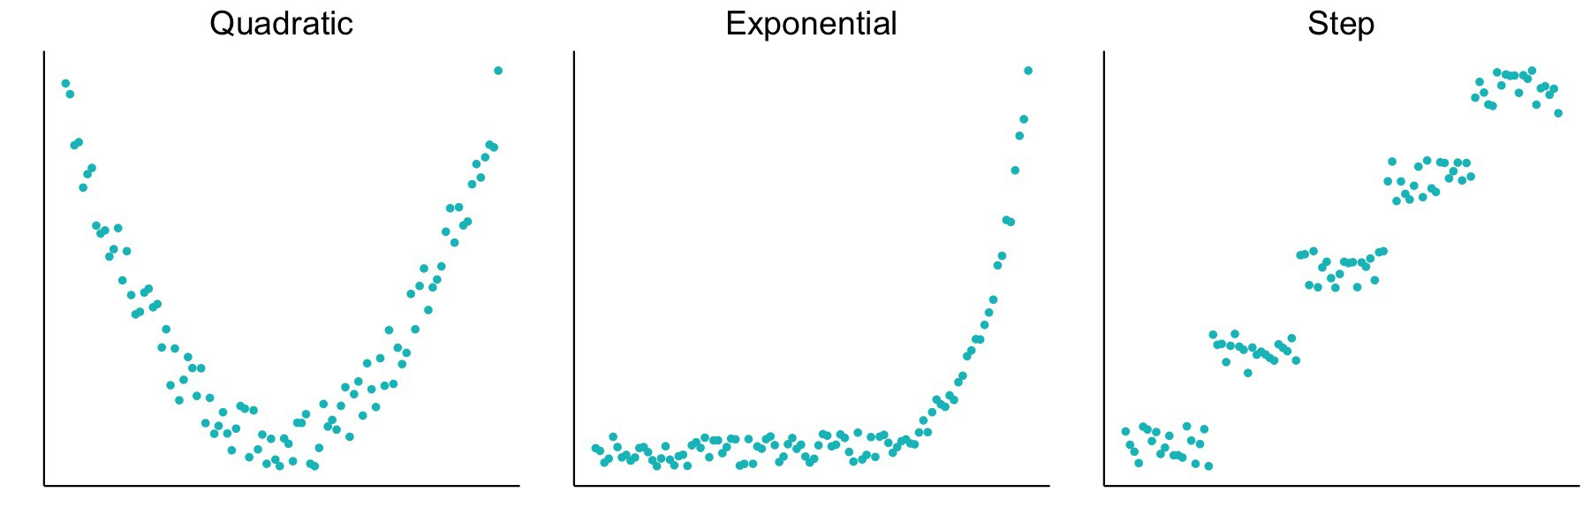
Non-linear Relationship

Slide 14
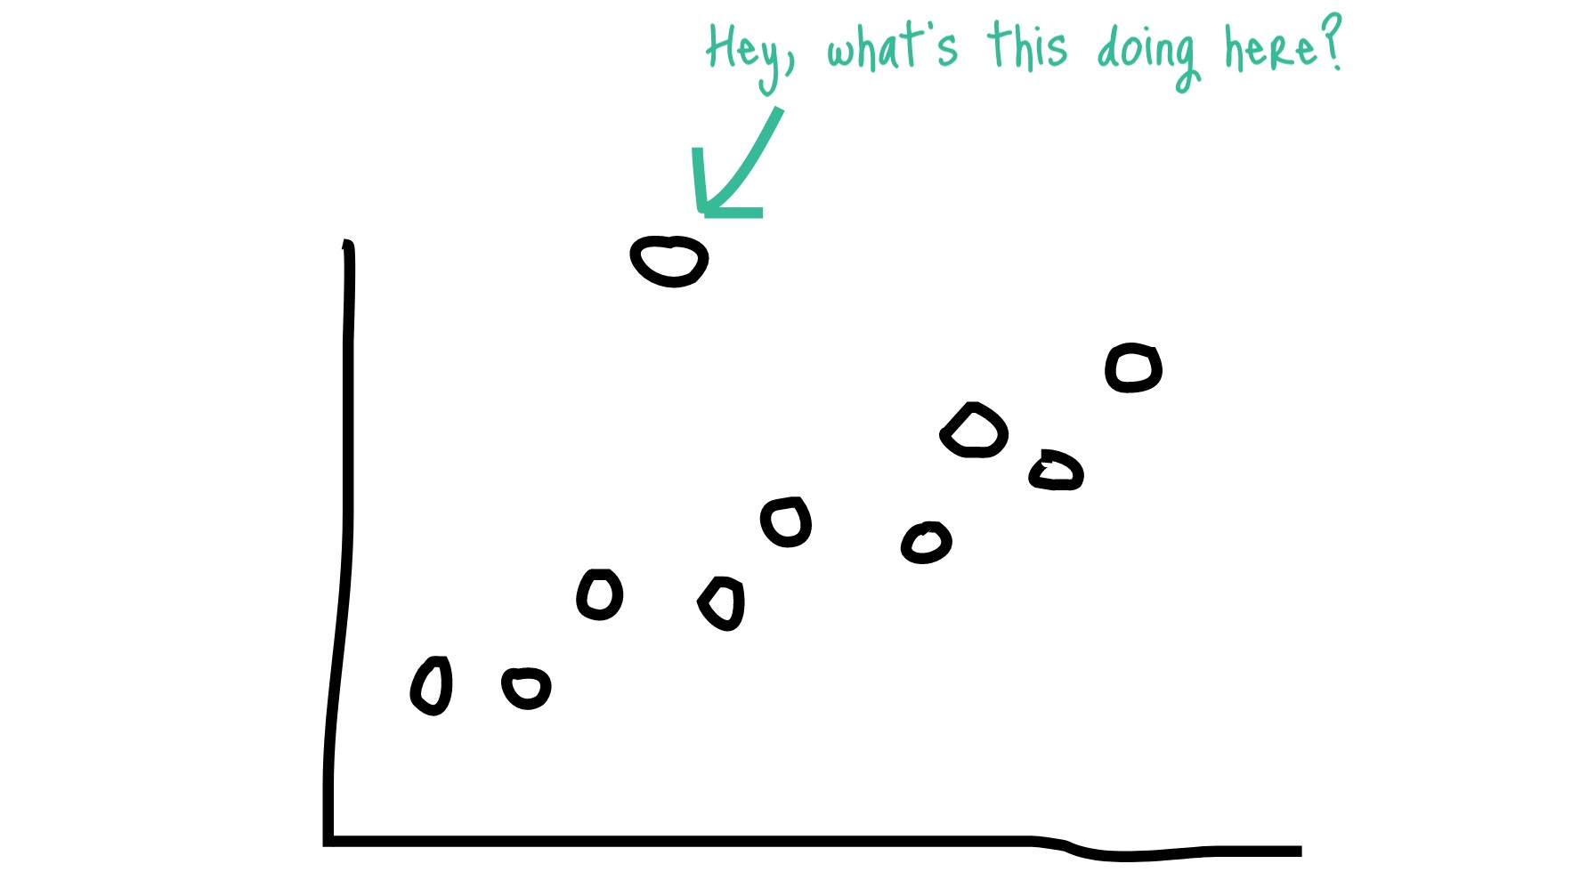
Linear Regression
Y =α + βX
H0: β = 0
P > or = 0.05
H1: β ≠ 0
P < 0.05
R² gives the amount of variance in the outcome explained by the model!!
Betweem 0 and 1

Slide 15
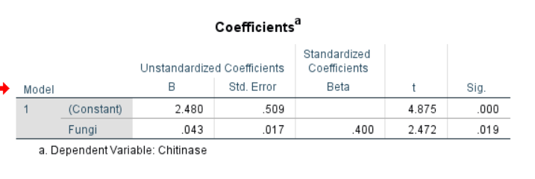

Slide 16
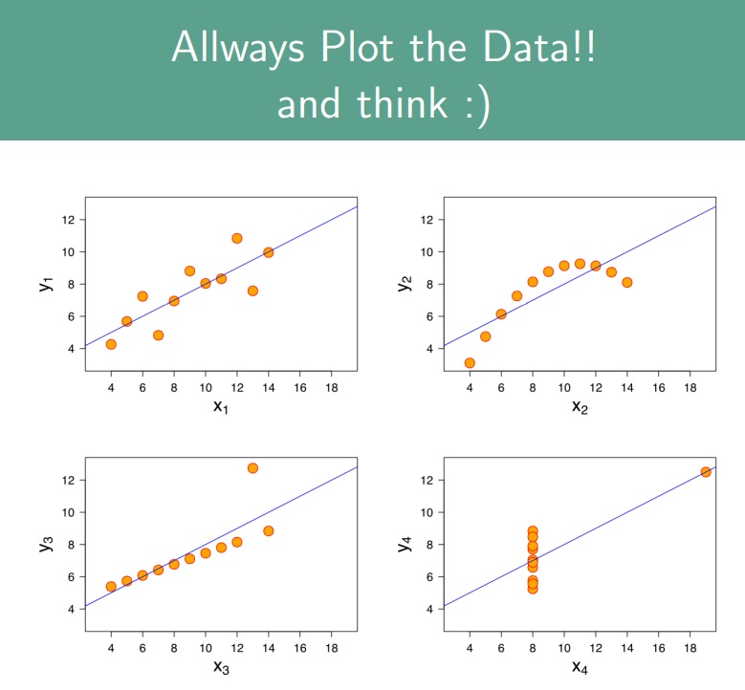

Slide 17
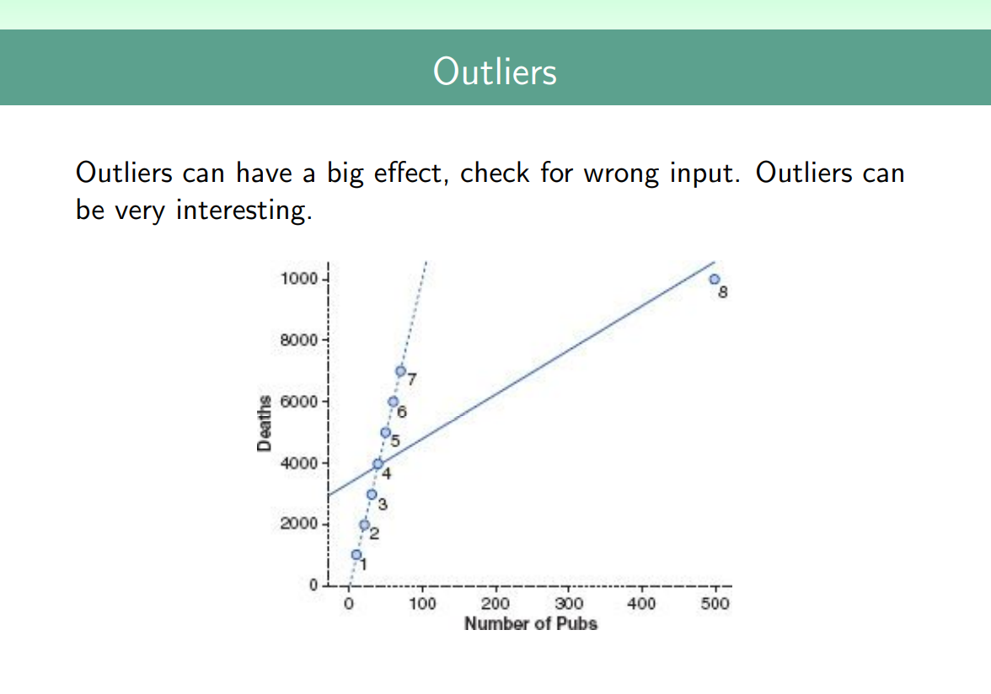

Slide 18
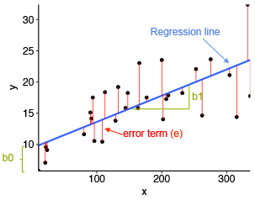
Assumptions
Response and Predictors must be numerical
Residuals have to be normally distributed
The variance of the residuals should be homogeneous (homoscedasticity)
The size of the sample should be at least 6 to 10 times the number
of predictors

Slide 19
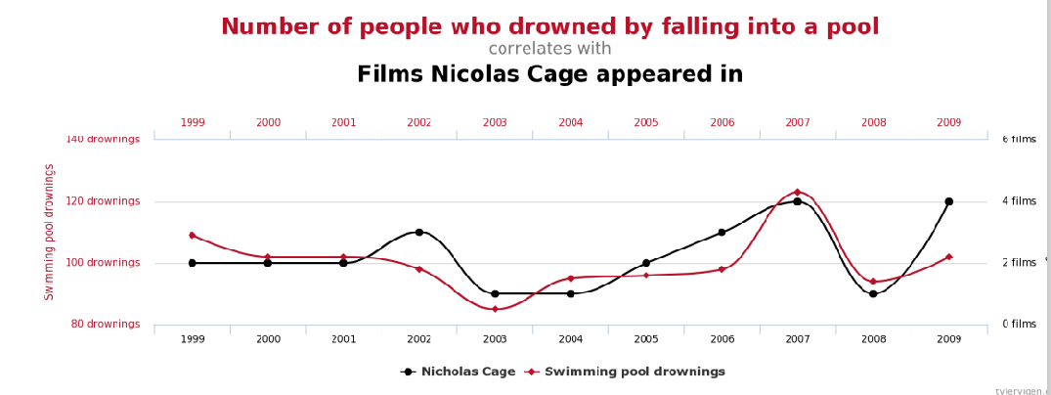
Always remember: you are a biologist, think of biological argumentations for your predictors. Do not believe everything the computer tells you. This are only models!!!

